Slide 1


GPT Harihara
IOT-BASED SMART FCTORY SYSTEM WITH SENSOR INTEGRATION AND CLOUD CONNECTIVITY PROJECT
Presented by: Gagan M Kakol

Slide 2
OVERVIEW
Introduction
Motivation
Abstract
Objectives
Approach and Methodology
Block Diagram
Working Principles
Hardware and Software Details
Results
Future scope
Conclusion
Reference

Slide 3
INTRODUCTION
The IoT-based Smart Factory System with Sensor Integration and Cloud Connectivity project uses the power of Internet of Things technologies. By combining various sensors and connecting them to the cloud connectivity, we create a smooth and seamless system, this system revolutionizes factory operations by enabling automation, optimization, and real-time monitoring.

Slide 4
These sensors encompass temperature and humidity sensors, flame sensors, infrared (IR) sensors for product counting, and load cells for precise weight measurement. The data collected from these sensors serves as a valuable resource, offering deep insights into the factory environment and facilitating informed decision-making for enhanced operational efficiency.

Slide 5
MOTIVATION
By Optimizing IoT technologies, sensor integration, and cloud connectivity, the project aims to automate processes, enable real-time monitoring, and optimize resource utilization in a smart factory environment. The goal is to improve operational performance, reduce costs, minimize downtime, and achieve better overall control and management of the manufacturing processes.

Slide 6
ABSTRACT
The smart factory project utilizes an ESP8266 microcontroller and Thinger.io platform to create an automated system. It incorporates five sensors, including an IR sensor, flame sensor, DHT11 temperature and humidity sensor, light sensor, and load cell. The system also features three to five actuators such as a fan, motor, LED, and buzzer.

Slide 7
The LCD display provides real-time information. The project enhances automation, efficiency, and safety in a factory environment through remote monitoring and control.

Slide 8
OBJECTIVES
In an IoT-based smart factory system that integrates various sensors and actuators for automation and monitoring purposes.
Enable remote monitoring and control of the factory environment to enhance efficiency, productivity, and safety.

Slide 9
Improved conveyor belt to count the products automatically and informs the operator to improve operational performance
To improve shipping the Weighing scale machine is used for vehicle tracking to maintain the quality of products without any damage
For worker safety, the safety fire extinguisher is implemented to enhance the efficiency of the factory

Slide 10
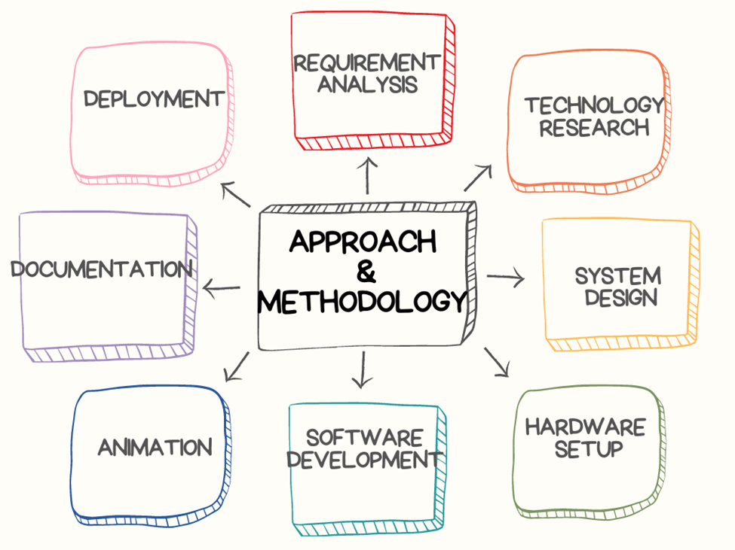
APPROACH & METHODOLOGY

Slide 11
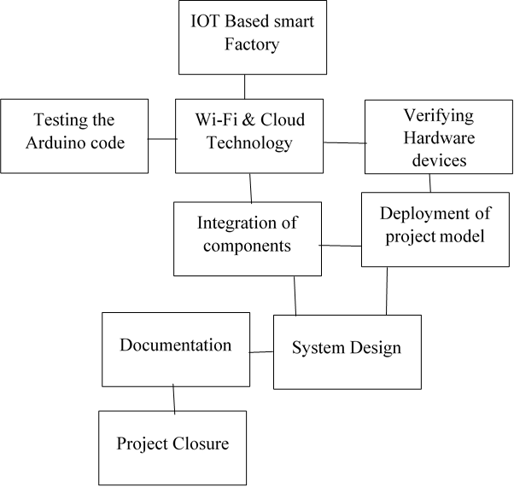
APPROACH & METHODOLOGY

Slide 12
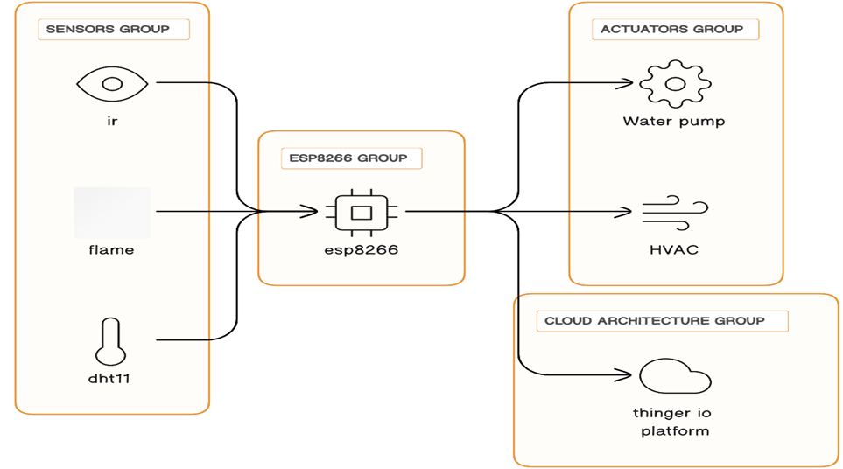
BLOCK DIAGRAM

Slide 13
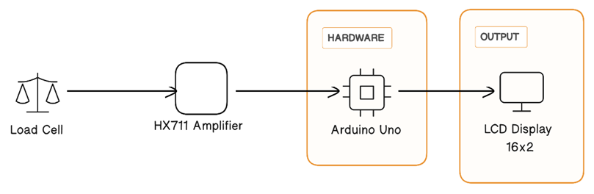
BLOCK DIAGRAM

Slide 14
WORKING PRINCIPLES
The smart factory project works on a combination of sensors and actuators to create an automated system.
The sensors, including the IR sensor, flame sensor, DHT11 temperature, and humidity sensor, and load cell, continuously monitor various parameters in the factory on the thinger.io dashboard.

Slide 15
The sensor data is processed by the ESP8266 microcontroller, which communicates with the Thinger.io platform via Wi-Fi connectivity.
The Thinger.io platform acts as a central hub for collecting, and analyzing the sensor data in real time, providing instructions for factory operations.
Based on the sensor readings, the system instructs actions through the actuators such as controlling the fan, motor, and buzzer.

Slide 16
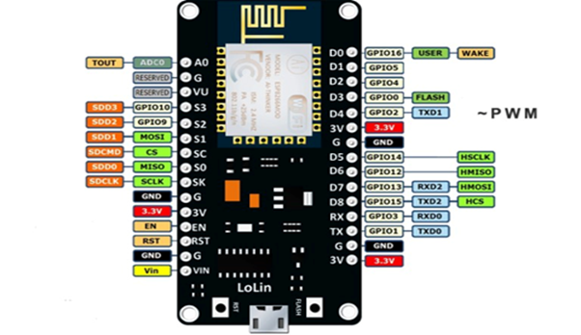
HARDWARE & SOFTWARE DETAILS
ESP8266
Microcontroller: Tensilica 32-bit RISC CPU Xtensa LX106
Operating Voltage: 3.3V
Input Voltage: 7-12V
Digital I/O Pins (DIO): 16
Analog Input Pins (ADC): 1
Flash Memory: 4 MB
SRAM: 64 KB
Clock Speed: 80 MHz

Slide 17
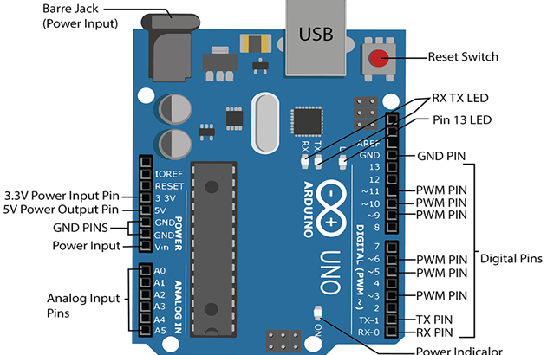
2. Arduino Uno
Microcontroller: ATmega328P – 8-bit AVR family microcontroller
Operating Voltage: 5V
Input Voltage: 6-20V
Digital I/O Pins (DIO): 14
Analog Input Pins (ADC): 6
Flash Memory: 32 KB
SRAM: 2 KB
Clock Speed: 16 MHz

Slide 18
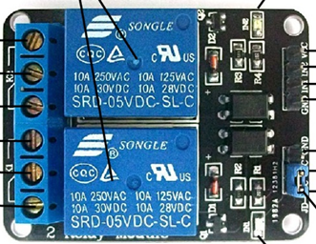
3. Relay
Supply voltage – 3.75V to 6V
Trigger current – 5mA
Current when the relay is active -
~70mA (single), ~140mA (both)
Relay maximum contact voltage –
250VAC, 30VDC
Relay maximum current – 10A

Slide 19
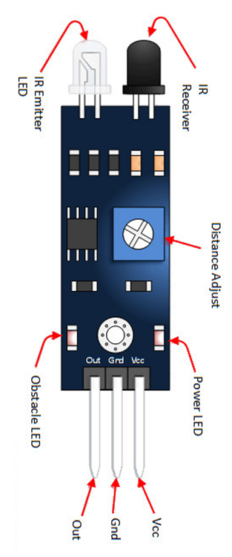
4. IR Sensor
5VDC Operating voltage
I/O pins are 5V and 3.3V compliant
Range: Up to 20cm
Adjustable Sensing range
Built-in Ambient Light Sensor
20mA supply current

Slide 20
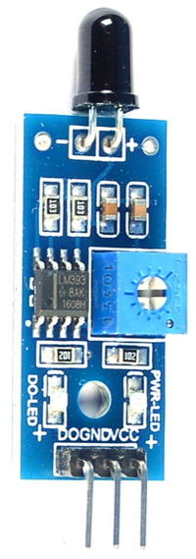
5. Flame Sensor
The range of operating voltage ranges from 3.3V to 5V.
The operating current is 15 mA.
The comparator chip used is LM393.
The range of the spectrum is from 760nm to 1100nm
The operating temperature ranges from -25℃ to 85℃.

Slide 21
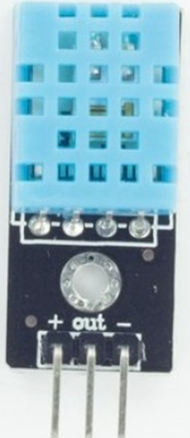
6. DHT11 Sensor
Operating Voltage: 3.5V to 5.5V
Operating current: 0.3mA (measuring) 60uA (standby)
Output: Serial data
Temperature Range: 0°C to 50°C
Humidity Range: 20% to 90%
Resolution: Temperature and Humidity both are 16-bit
Accuracy: ±1°C and ±1%

Slide 22
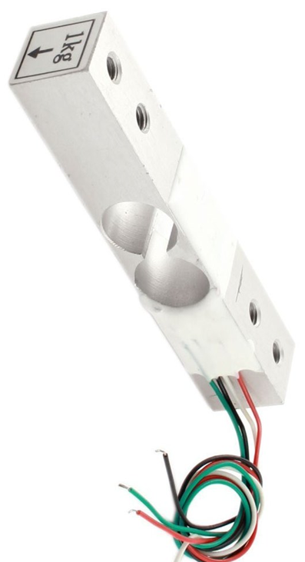
7. Load cell Sensor
Differential input voltage: ±40mV
Data accuracy: 24-bit
Refresh frequency: 10/80 Hz
Operating Voltage: 2.7V to 5VDC
Operating current: <10 mA
1kg Load Cell Measuring Range

Slide 23
RESULTS
Improved operational efficiency, reduced downtime, and optimized resource allocation.
Enhanced quality control, consistent product quality, and reduced defects.
Cost savings and waste reduction through energy optimization and process improvements.
Streamlined decision-making with real-time data monitoring and intuitive interfaces.

Slide 24
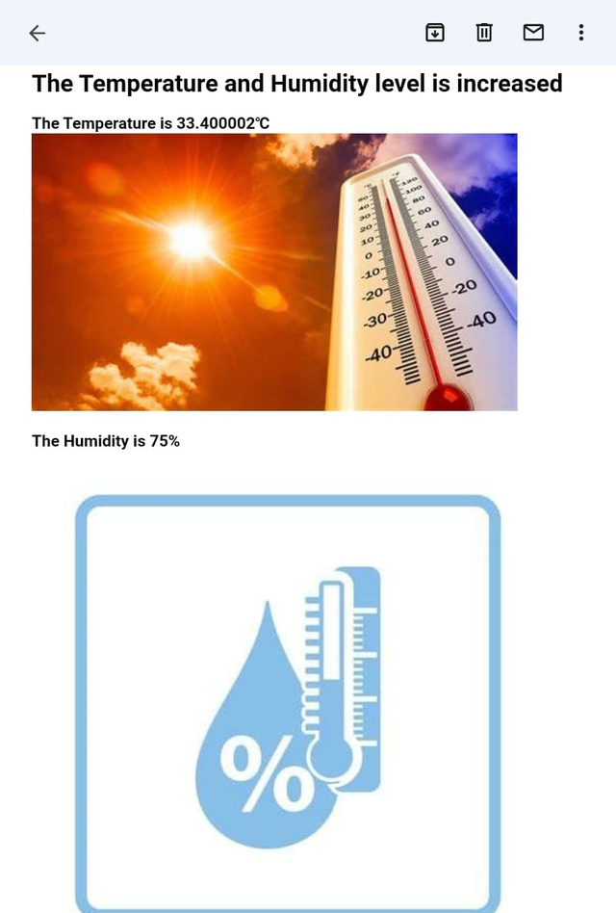
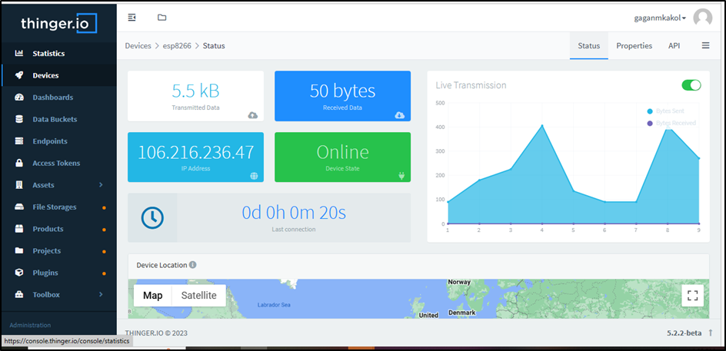
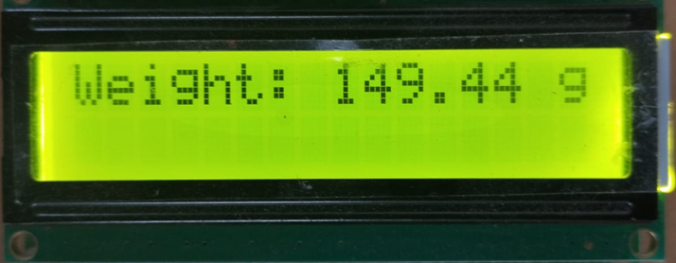

Slide 25
FUTURE SCOPE
The future scope of the Smart Factory System includes predictive maintenance, advanced robotics, data analytics, and enhanced connectivity for improved production efficiency and supply chain management.

Slide 26
FUTURE SCOPE
Here are some technologies for future development in the area of Smart Factory.
Robotics
Artificial Intelligence
Machine Learning
Supply Chain Management

Slide 27
CONCLUSION
The smart factory project successfully demonstrates the integration of an ESP8266 microcontroller, Thinger.io platform, and a range of sensors and actuators to create an automated and intelligent system. The project enables remote monitoring and control of the factory environment, enhancing efficiency, safety, and productivity. Real-time data visualization and analysis provided by Thinger.io facilitate informed decision-making and optimization of factory processes.

Slide 28
REFERENCE
·B. Chen, J. Wan, L. Shu, P. Li, M. Mukherjee and B. Yin, "Smart Factory of Industry 4.0: Key Technologies, Application Case, and Challenges," in IEEE Access, vol. 6, pp. 6505-6519, 2018, doi: Smart Factory of Industry 4.0: Key Technologies, Application Case, and Challenges | IEEE Journals & Magazine | IEEE Xplore
Flame Sensor : Working, Types, Interfacing & Its Applications (watelectronics.com)
1KG Load Cell - Weight Sensor for Electronic kitchen weighing Scale – QuartzComponents

